Slide 1

1000 Movies Data - EDA
By Manish K

Slide 2
Story
Given a set of 1000 movies from 2006-2016, need to understand the trends and get insights into the same.

Slide 3
Dataset Analysis
Total rows | RangeIndex: 1000 entries, 0 to 999
Column Name
Rank | 1000 non-null int64
Title | 1000 non-null object
Genre | 1000 non-null object
Description | 1000 non-null object
Director | 1000 non-null object
Actors | 1000 non-null object
Year | 1000 non-null int64
Runtime (Min) | 1000 non-null int64
Rating | 1000 non-null float64
Votes | 1000 non-null int64
Revenue (Millions) | 872 non-null float64
Metascore | 1000 non-null float64

Slide 4
Problem Statement
This dataset is collection of details about 1000 movies released from 2006-2016 time frame.
The goal is to identify how entertainment industries perform in 10 years based on revenue, ratings and industry trends.
The goal is also to identify audience and critics liking.
This dataset gives insight about successful Movies, Actors and Directors in mentioned timeframe.

Slide 5
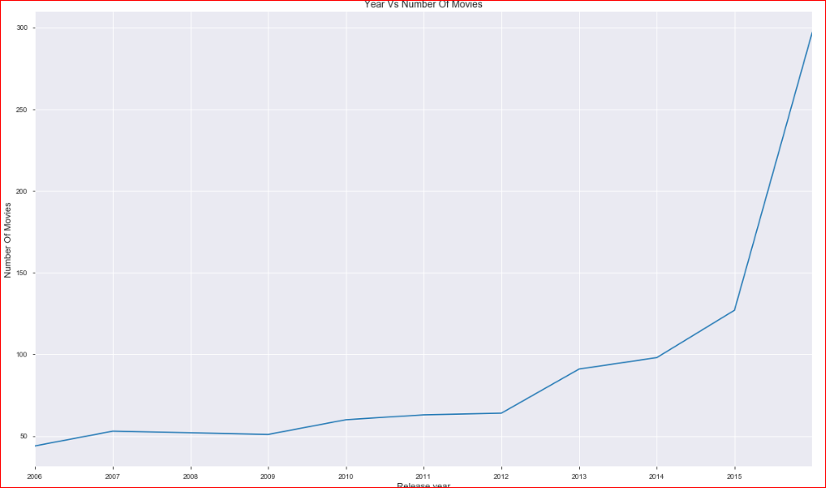
Movies Released Yearly
Till 2012, there were around ~50 average movies released yearly but exponential growth observed after year 2012.

Slide 6
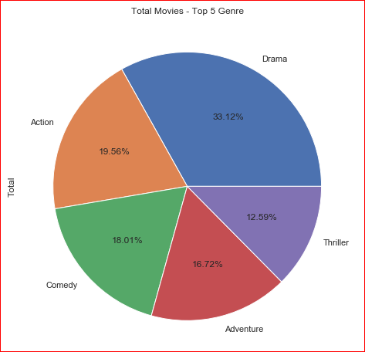
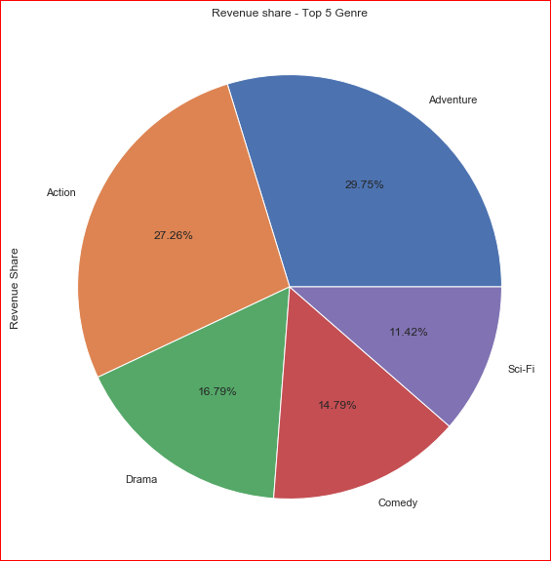
Top 5 – Movie Genre
Drama movies were produced in higher number followed by Action, Comedy and Adventure.
Whereas Adventures movies generated maximum revenue followed by Action and Drama.
Even though highest Drama movies got released but audience like Adventure movies more.

Slide 7
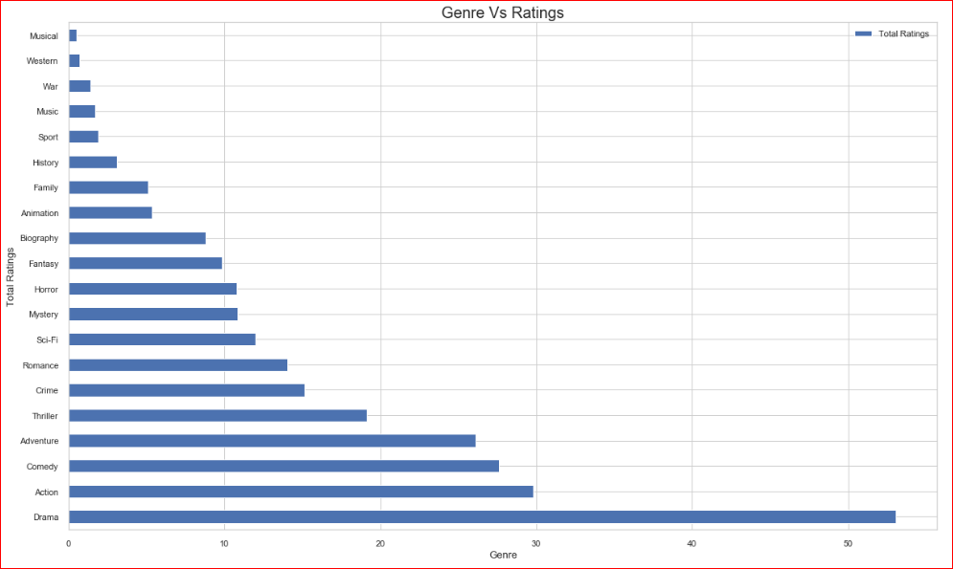
Genre Ratings
Drama movies were highly rated movies followed by Action, Comedy and Adventure.
The least favorite movies were Musical, Western and War.

Slide 8
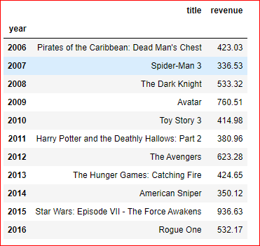
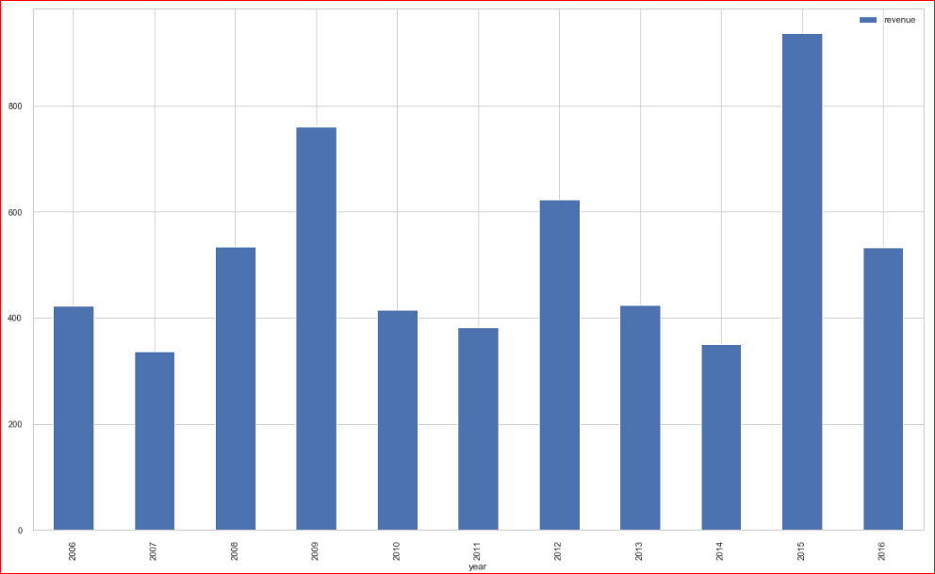
Highest revenue generated movies year wise
Table shows the highest revenue generated movies in a year.

Slide 9
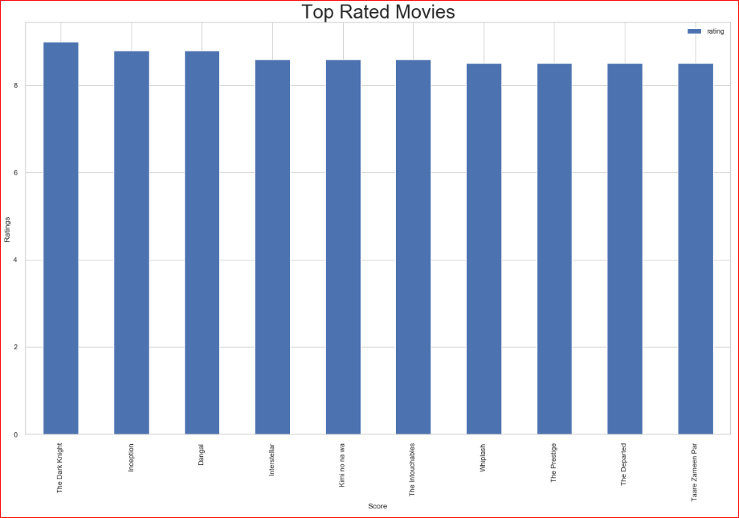
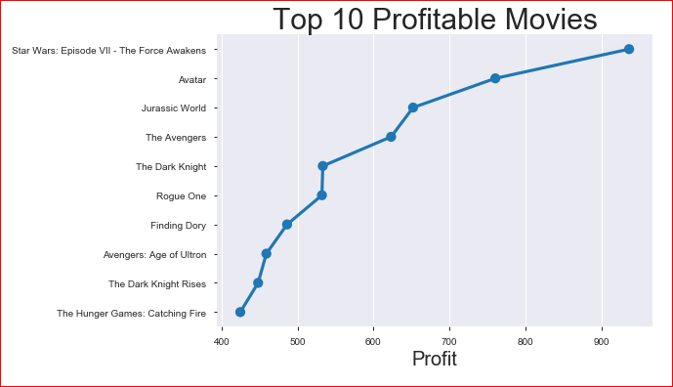
Top rated movies Vs Revenue
Based on Top rated and profitable movies graph – “The Dark Knight” was highest rated movie.
“Star wars Episode VII – The Force Awakens” was the highest profitable movie
Ratings and profitability may not be related to each other.

Slide 10
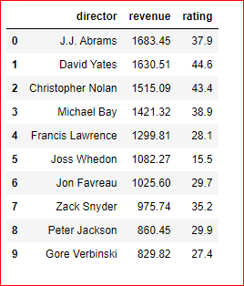
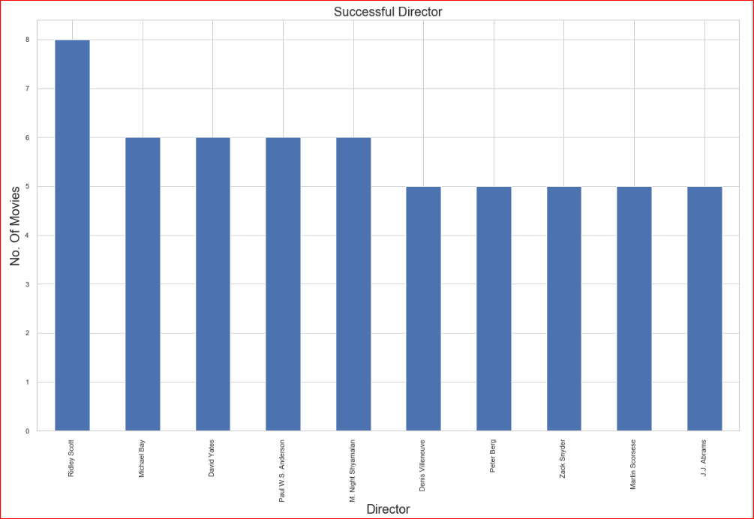
Successful Director
“Ridley Scott” was a director who directed highest number of movies from 2006 to 2016 where as “J.J Abrams” produced 5 movies but generated highest revenue.

Slide 11
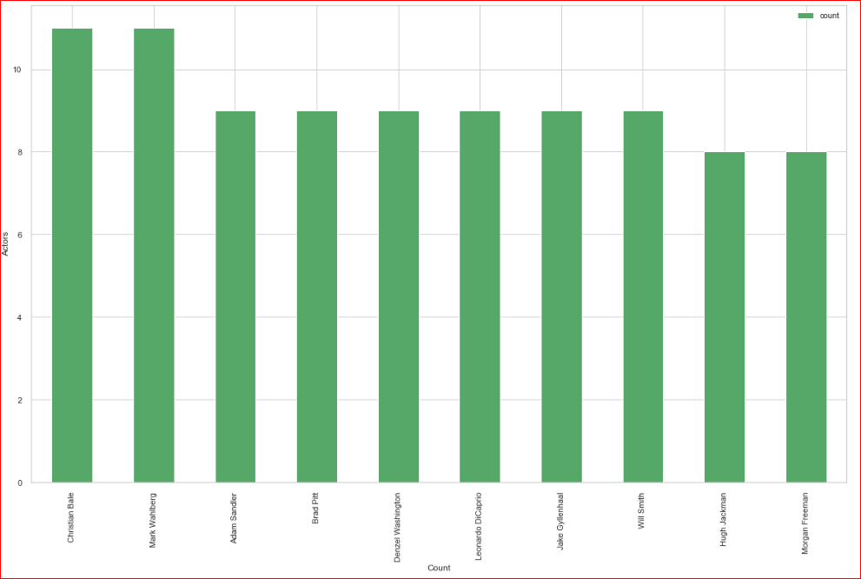
Actor
“Christian Bale” and “Mark Walberg” were acted in highest number of movies. Both acted in 11 films during 2006 to 2016.

Slide 12
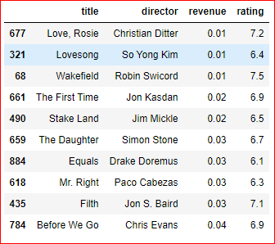
Top 10 – High Rated Vs low Revenue movies
Table shows high rated with low revenue movies, “Love, Rosie” were generated lowest revenue among all.
There were no movies with high revenue and low ratings.
There might be the chances that revenue were not properly captured in dataset.
This shows – good ratings movies are generating high revenue.

Slide 13
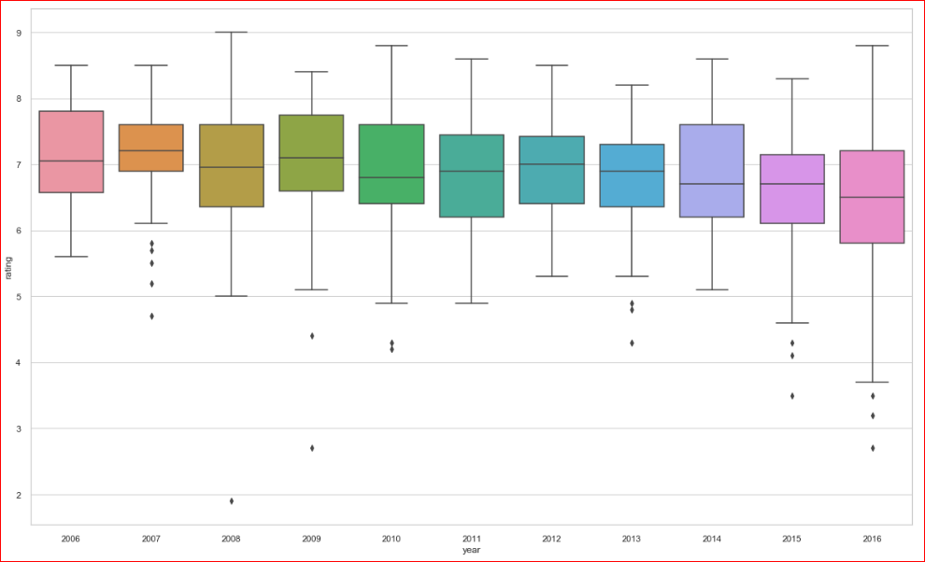
Trends - Ratings
Highest ratings movie got released in year 2007 with few exceptions.
Data shows Avg. ratings are going down on year by year basis.

Slide 14
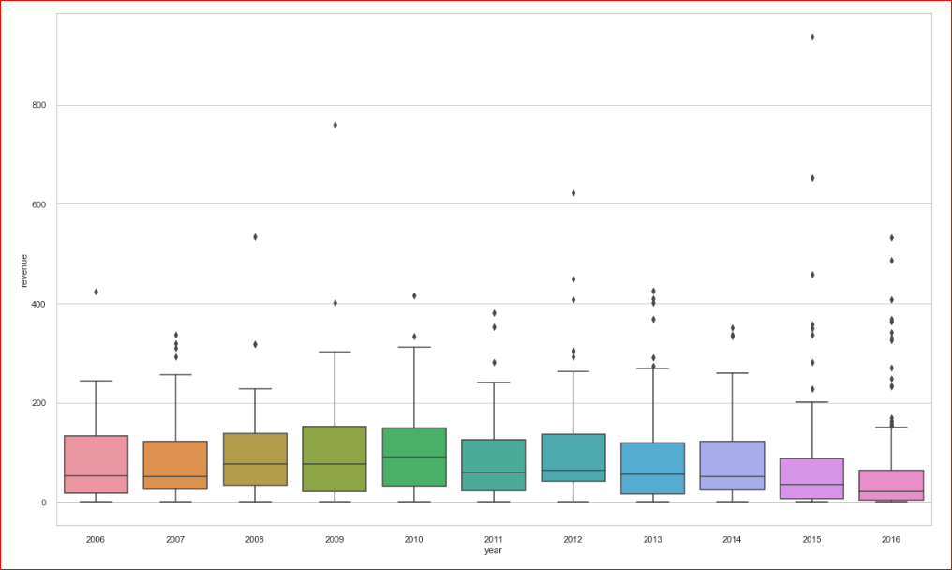
Trends - Revenue
Industries was profitable in year 2010 with maximum revenue generation .

Slide 15
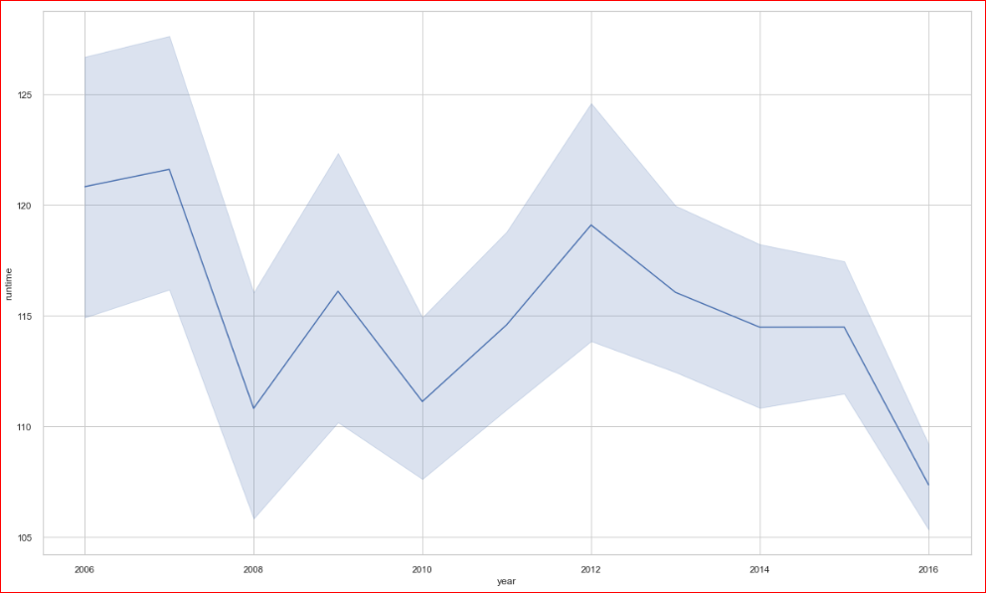
Trends - Runtime
Data shows people are liking short movies as Avg. runtime is going down year by year.

Slide 16
Conclusion
The data set gives us insights about the 1000 movies released between 2006 to 2016.
There were total 229 movies rated with highest ratings.
There was the exponential growth of movies produced in the year of 2016.
Drama was most popular genre followed by Action, Comedy and Adventure.
The least favorite genres were Musical, Western and War.
Even though Drama was most popular genre but Adventures movies collected highest revenue.
Highest revenue generated movie was "Star Wars: Episode VII - The Force Awakens" .
Most popular actor was "Christian Bale“.
Most successful director was "J.J. Abrams".
The highest rated movie was "The Dark Knight“.
Year 2010 was the successful year for the industry in terms of revenue.
Based on data, audience are preferring short movies.

Slide 17
Thank You…

